Slide 1

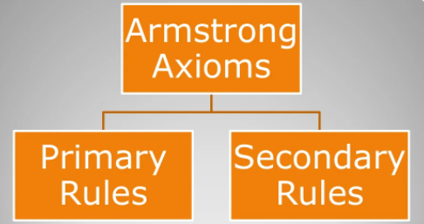
Database Management System (BCSC–1003)
Topic: Armstrong Axioms (Inference Rules)
Mr.Prateek Kumar Soni
Assistant Professor, Dept. of CEA, GLA University, Mathura.

Slide 2

Armstrong Axioms (Inference Rule) in Functional Dependecy in DBMS
Introduction to Axioms Rules:
Armstrong's Axioms is a set of rules.
It provides a simple technique for reasoning about functional dependencies.
William W. Armstrong developed it in 1974.
It is used to infer all the functional dependencies on a relational database.

Slide 3
Armstrong Axioms (Inference Rule)
Armstrong Axioms can be classified as:

Slide 4
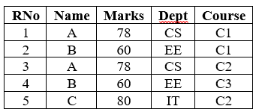
Armstrong Axioms (Inference Rule)
Consider a relation STUDENT

Slide 5
Primary Rules
Rule 1. Reflexivity
{A → A} and,
If A is a set of attributes and B is a subset of A, then A holds B. {A → B}. This is trivial property.
Example:
RNo → RNo (✓)
(RNo, Name) → Name (✓)

Slide 6
Primary Rules
Rule 2. Augmentation
If A → B holds and Y is attribute set, then AY → BY also holds.
That means adding attributes in dependencies, does not change the basic dependencies.
If A → B, then AC → BC for any C.
Example:
If RNo → Name (✓)
then {RNo, Marks} → {Name, Marks} (✓)

Slide 7
Primary Rules
Rule 3. Transitivity
If A holds B and B holds C, then A holds C.
It means if {A → B} and {B → C}, then {A → C}.
A holds B {A → B} means that A functionally determines B.
Example:
If Name → Marks (✓) and Marks → Dept (✓)
then Name → Dept (✓)

Slide 8
Secondary Rules
Rule 1. Union
If {A → B} and {A → C}, then {A → BC}
Example:
If RNo → Name (✓) and RNo → Marks (✓)
then RNo → Name, Marks (✓)

Slide 9
Secondary Rules
Rule 2. Decomposition or Splitting property
If {A → BC} then {A → B} and {A → C}
But if AB → C then we can’t split the LHS as A → C and B → C
Example:
If (RNo → Name, Marks) (✓)
Then (RNo → Name) (✓) and (RNo → Marks) (✓)

Slide 10
Secondary Rules
Rule 3. Pseudo Transitivity
If{A → B} and {BC → D}, then {AC → D}
Example:
RNo → Name (✓) and (Name, Marks) → Dept (✓)
then (RNo, Marks) → Dept (✓)

Slide 11
Secondary Rules
Rule 4. Composition
If X → Y and A → B then XA → YB
Example:
RNo → Name (✓) and Marks → Dept (✓)
then (RNo, Marks) → (Name, Dept) (✓)

Slide 12
Example
Question: Consider relation E = (P, Q, R, S, T, U) having set of following Functional Dependencies (FD).
P → Q P → R QR → S
Q → T QR → U PR → U
Calculate some members of Axioms are as follows:
P → T
PR → S
3. QR → SU
4. PR → SU

Slide 13
Example
Solution:
P → T
In the above FD set, P → Q and Q → T
So, Using Transitive Rule: If {A → B} and {B → C}, then {A → C}
∴ If P → Q and Q → T, then P → T.
P → T

Slide 14
Example
2. PR → S
In the above FD set, P → Q
As, QR → S
So, Using Pseudo Transitivity Rule: If{A → B} and {BC → D}, then {AC → D}
∴ If P → Q and QR → S, then PR → S.
PR → S

Slide 15
Example
3. QR → SU
In above FD set, QR → S and QR → U
So, Using Union Rule: If{A → B} and {A → C}, then {A → BC}
∴ If QR → S and QR → U, then QR → SU.
QR → SU

Slide 16
Example
4. PR → SU
So, Using Union Rule: If{A → B} and {A → C}, then {A → BC}
∴ If PR → S and PR → U, then PR → SU.
PR → SU

Slide 17
References
Korth, Silbertz and Sudarshan (1998), “Database Concepts”, 4th Edition, TMH.
Elmasri and Navathe (2010), “Fundamentals of Database Systems”, 5th Edition, Addision Wesley.
Date C J,” An Introduction to Database Systems”, 8th Edition, Addision Wesley.
M. Tamer Oezsu, Patrick Valduriez (2011). “Principles of Distributed Database Systems”, 2nd Edition, Prentice Hall.

Slide 18


